Slide 1
TRAVEL PACKAGE BOOKING SYSTEM
Sub Code: CS6103
Sub Name: Application Development Practices
SASANA R 2020503542
SURIYAA V 2020503550
Department of Computer Technology, Anna University, MIT Campus

Slide 2
Problem Statement
The basic idea was to solve the problem of tourists who are highly interested in traveling and exploration. Moreover they can get a compact platform to solve their problems regarding any query.
With the most recent developments and changes in the business environment, data and information must be effectively gathered, managed and stored in order to keep pace and compete in the field of tourism. Thus, an easier and cost-efficient manner of handling information is necessary.
According to a study by Google, the average traveler looks at 380 web page visits through 34 different searches over a period of two month. Hence, travel bookings are very time-consuming. Booking via a travel agency website can certainly save time and improve the overall travel experience.

Slide 3
Abstract
This project “TRAVEL PACKAGE BOOKING SYSTEM” is used to automate all process of the travel and tourism.
This deals with creation, booking and confirmation of travel packages.
Travel package booking system is used to book a tour from anywhere in the world by a single dynamic website.
This will help the user to know all about the places and tour details in a single website.
We can add packages to the website from different cities and hotels, flights by creating a tour page.
The users can sign in and book any package in the website. The user can see the confirmation in their, my booking page.
It will be an easier platform for all the travelers in having a hassle free holiday season.

Slide 4
Introduction
‘Master Plaiting’ is a Travel booking website. It is simply an online way of booking our holidays tour packages for booking destinations, flights and hotels in a single stop. Through this, a customer can maintain his travel planner in a compact way and helps him enjoy his holidays without any stress.The website will be available for 24x7 access to the users.The website will support proper searching and booking of travel packages according to the perfect location search.The system will provide social interaction tools such as contacts, Packages etc., to enable interaction amongst users and us to get the details of their requirement.The system will provide a unified itinerary and a planner for the customers.

Slide 5
Existing System
In the existing system, each task is carried out manually and processing is also a tedious job. In previous system travelers were maintaining time table details manually in pen and paper, which was time taking and costly. The traveler is not able to achieve his need in time and also the results may not be accurate. Because of the manual maintenance there are number of difficulties and drawbacks existing in this system.
Drawbacks of the Existing System.
Increased transaction leads to increased source document and hence maintenance becomes difficult.
If any admin, user entry is wrongly made then the processing becomes very difficult.

Slide 6
Proposed System
With the most recent developments and changes in the business environment, data and information can be effectively gathered, managed and stored in order to keep pace and compete in the field of Travel agency. Thus, an easier and cost-efficient manner of handling information will come in to place.This user-friendly software will provide the facility of searching and finding the right place to visit in different places of the world. Moreover one get a complete package with discounts at an affordable cost.This new system is very time efficient without any hassles and stress for the user. As, all the processes happen in a few clicks.

Slide 7
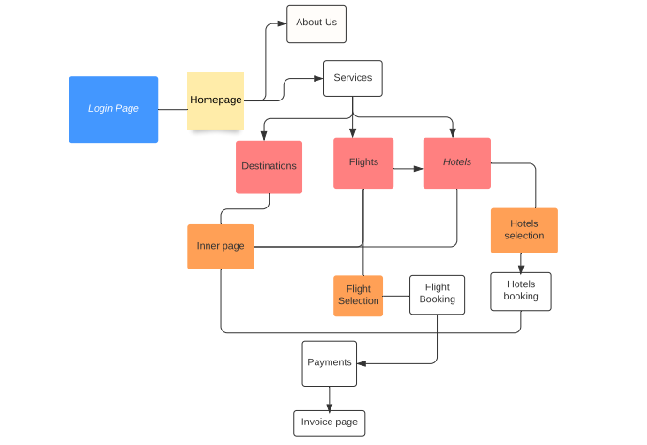
System Diagram/Flow Diagram
Flow chart:
LOGIN
REGISTER
HOME PAGE
DESTINATION
FLIGHTS
HOTELS
PAYMENTS
CONFIRMATION AND FINAL ITINERARY

Slide 8
System Requirements
Hardware
In client side, the client needs a PC with a web browser and with internet connection. In server side we need pc’s with internet connection to design the website.
Software
Apache,Tomcat, phpmyadmin, mySQL are used in the server side.
Domain Description
We used HTML, CSS, JS, and Servlets in our project for the front end and back end infrastructure development. Servlets receive and respond to requests from Web clients, usually across HTTP, the HyperText Transfer Protocol. HTML, JS and CSS is used for the design and the things we wanted to include in our website. Combining CSS, JS, JSP and HTML the total website is build.

Slide 9
Modules
Registration and Login module.
Destination module
Flights module
Flight preference
Flight booking
Hotels module
Hotel preference
Hotel booking
Payments module
Confirmation page and final Itinerary module

Slide 10
Registration and Login module
In this page, the user is allowed to create an account in our website. The user is asked to give their email id and the password of their preference.
Once the user registers in our website, he is allowed to login in his account.
In the login page, the user should provide the valid Email ID and his account password.
If the user provides a valid data then the page gets navigated to the homepage.

Slide 11
DESTINATION MODULE
In the home page, user is allowed to navigate through a host of cities and to the destination pages where details of each cities are given.
The famous spots in those places are listed and the total amount for these activities is also displayed here.
Once this is selected, next the page navigates to the flight bookings.
The user can also navigate straight to hotel booking by skipping the flight booking.

Slide 12
FLIGHTS MODULE
The user is asked to input his preference that is the place, date and number of passengers.
The flight details are displayed in another page where the user can book his flights according to his preference.
Once it is booked, the user should provide the travelers details.
Then the selected flight details is displayed and then by proceeding next, the page navigates you to the hotel page.
The user can also proceed for payment by skipping the hotel booking

Slide 13
HOTELS MODULE
In the hotels page, the user is asked to input the hotel preference that is place, check in , check out dates.
The various hotels will be displayed in another page.
Once the user select the hotel, the hotel details, the room details and the facilities available in there are displayed.
Once the user selects his preferred hotel, he is asked to input the traveler's details.
Finally the selected hotel details is displayed and the user can proceed for payment.

Slide 14
PAYMENTS MODULE
The payment is made in very simple steps.
Various options are displayed like Credit card, Debit card, Net banking and UPI.
Once the required details are provided by the user and payment step is continued by the user.
He is navigated to the confirmation page.

Slide 15
CONFIRMATION AND ITINERARY MODULE
Once the payment is successful, the user is navigated to the confirmation page .
In this page, the entire itinerary is displayed that is the place details ,the flight details and the hotel details. The user can download those details and save it for future purposes.

Slide 16
ADDITIONAL MODULES
The respective header and footer for each page is given.
The cancellation of the booking can also be done.
The current booking details can also be seen.

Slide 17
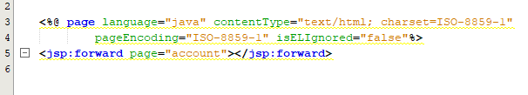
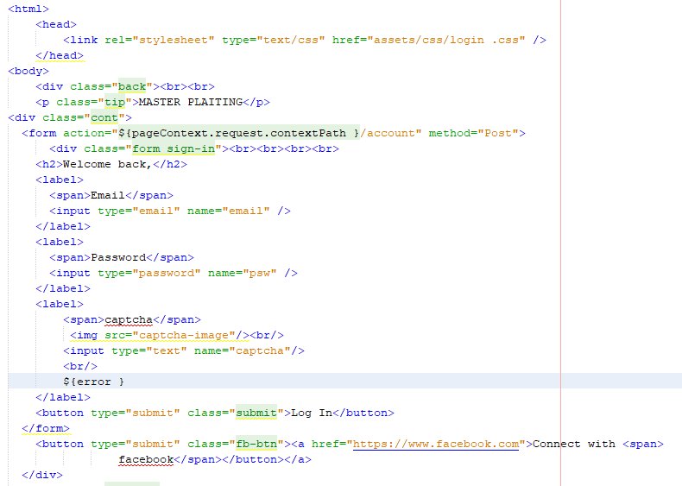
Front-End Code
Index.jsp

Slide 18
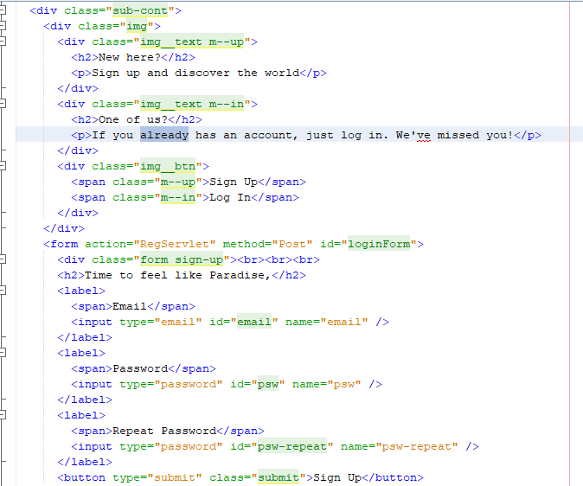
Front-End Code

Slide 19
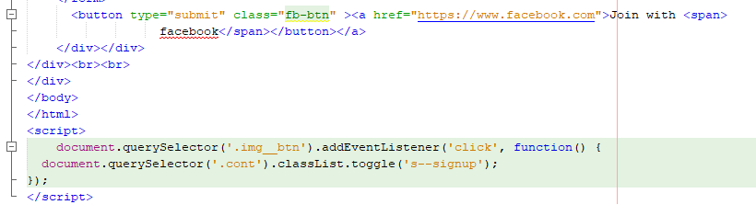
Front-End Code

Slide 20
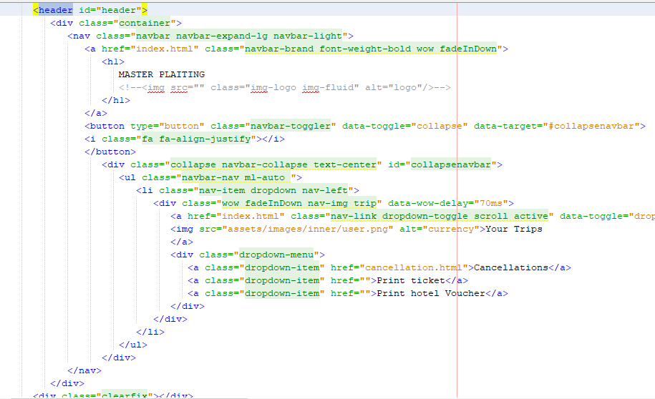
Front-End Code
HEADER AND FOOTER ARE COMMON TO ALL PAGES.

Slide 21
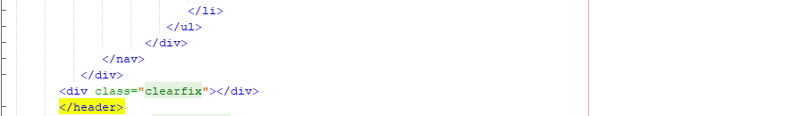
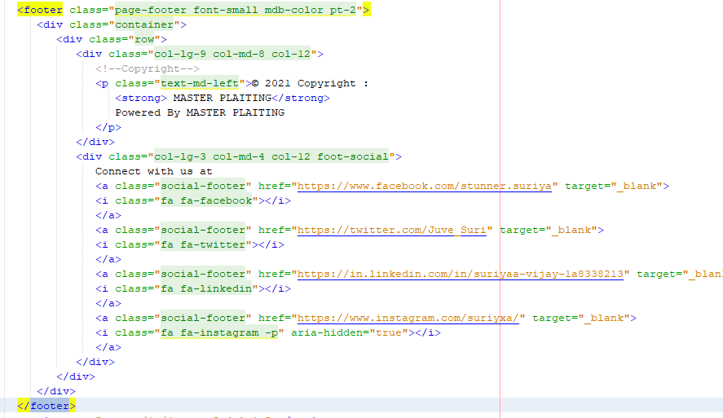
Front-End Code

Slide 22
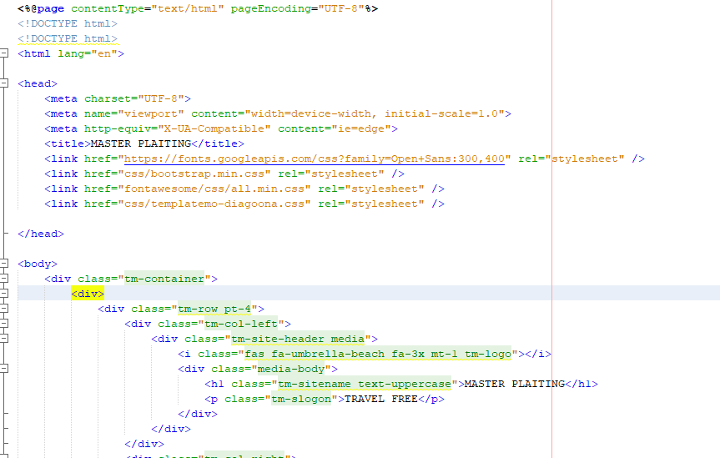
Front-End Code

Slide 23
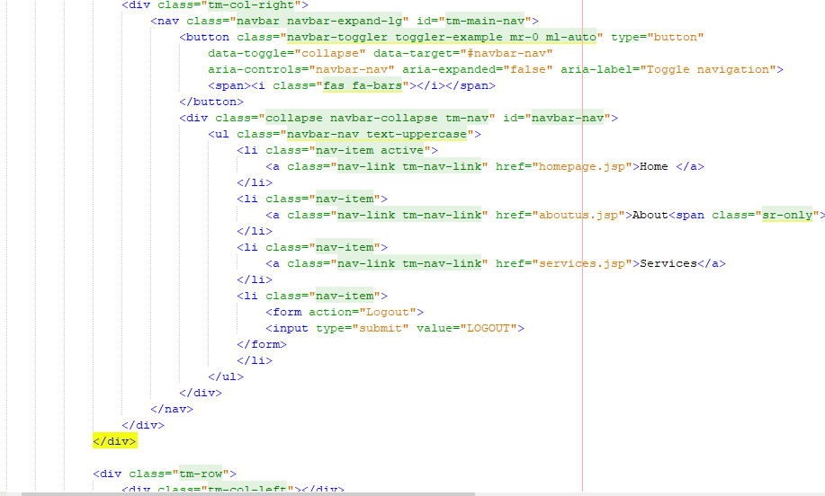
Front-End Code

Slide 24
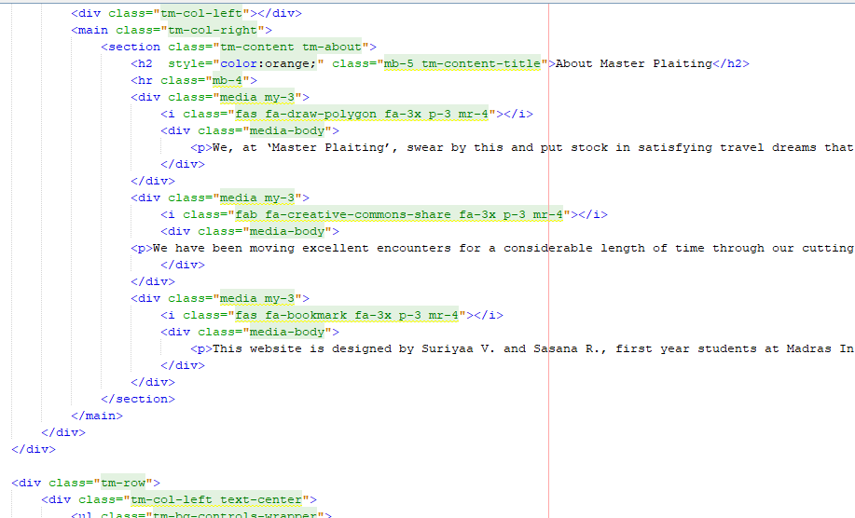
Front-End Code

Slide 25
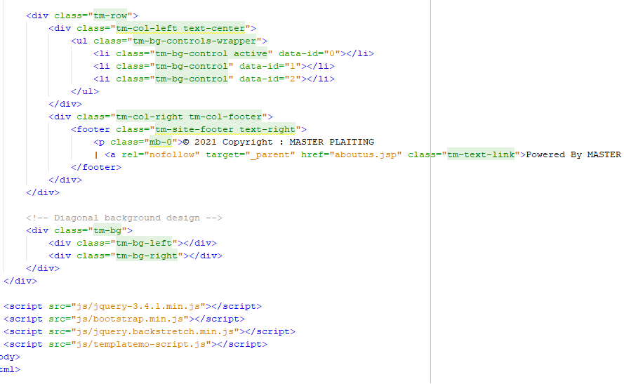
Front-End Code

Slide 26
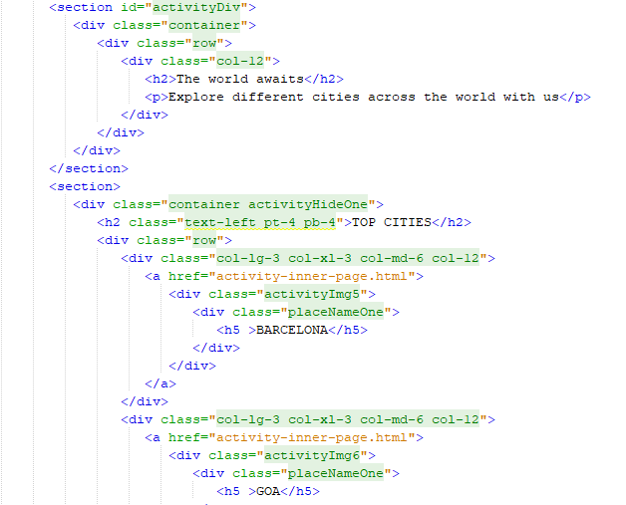
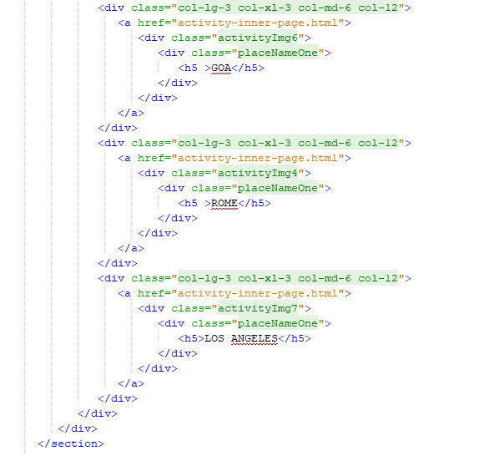
Front-End Code

Slide 27
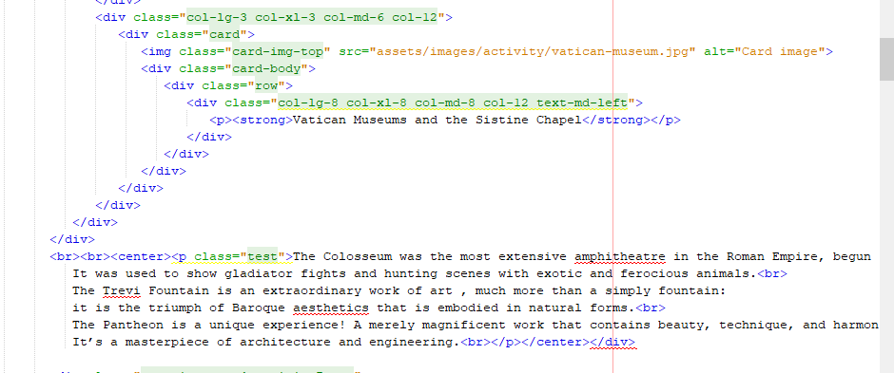
Front-End Code

Slide 28
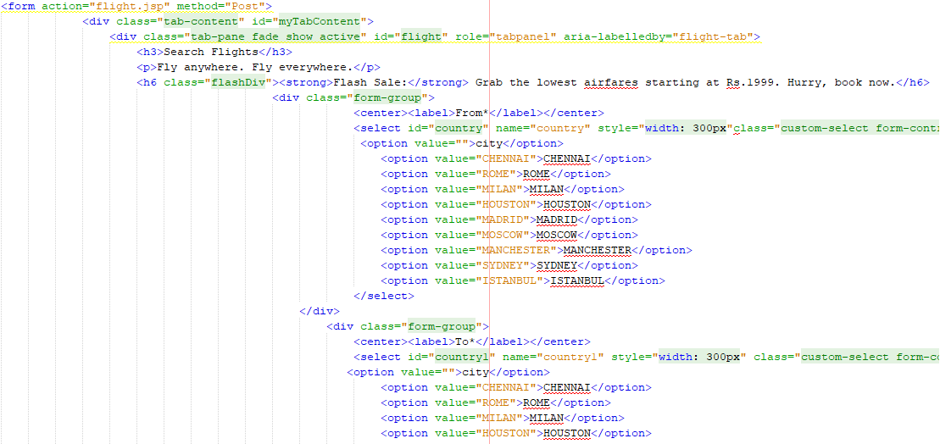
Front-End Code

Slide 29
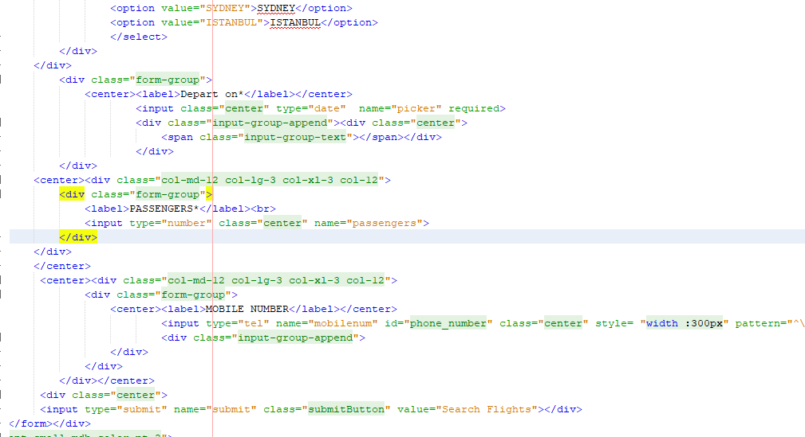
Front-End Code

Slide 30
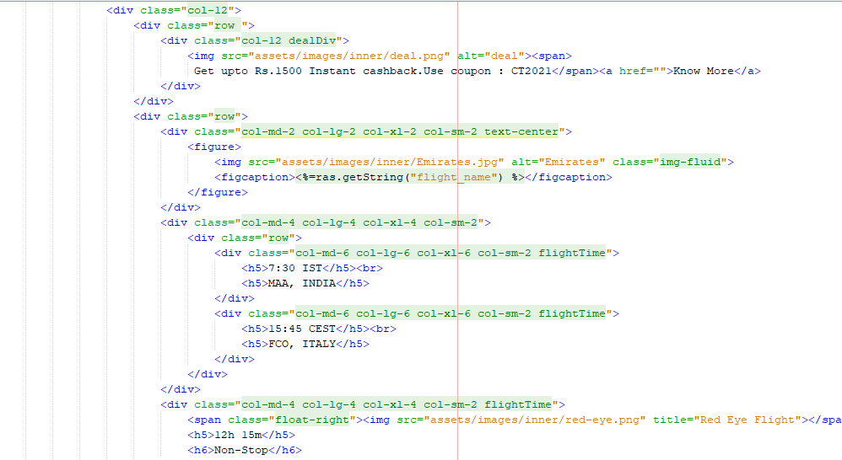
Front-End Code

Slide 31
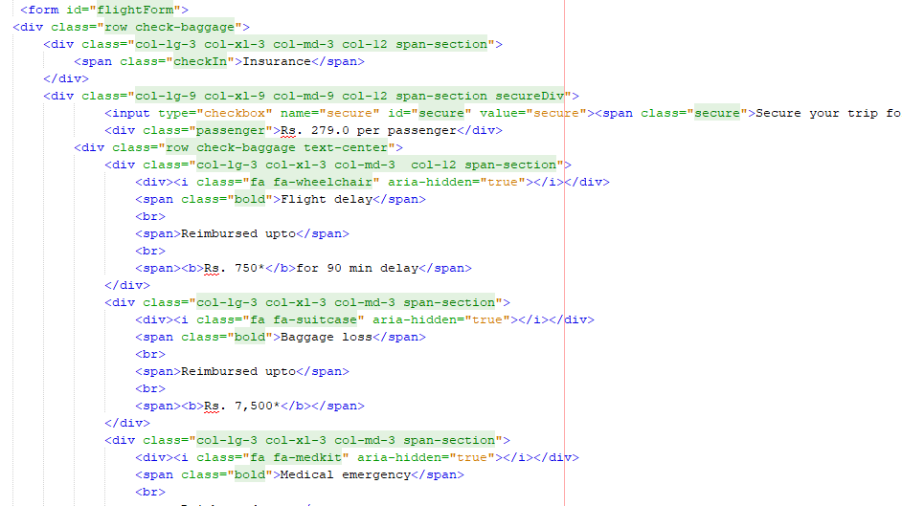
Front-End Code

Slide 32
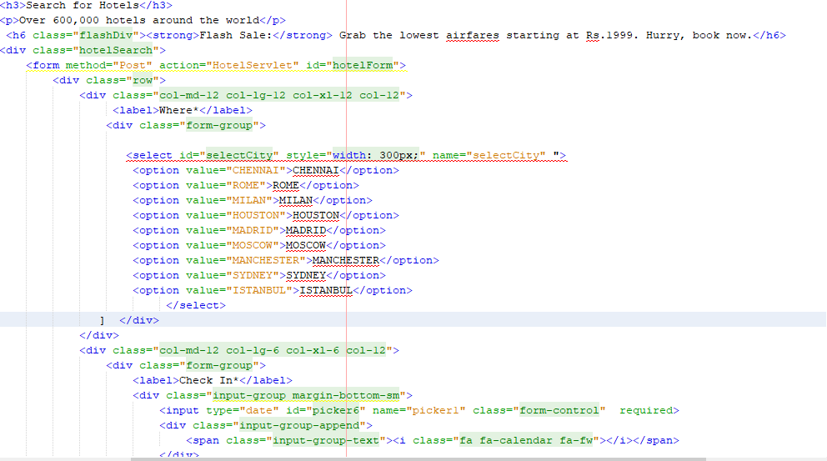
Front-End Code

Slide 33
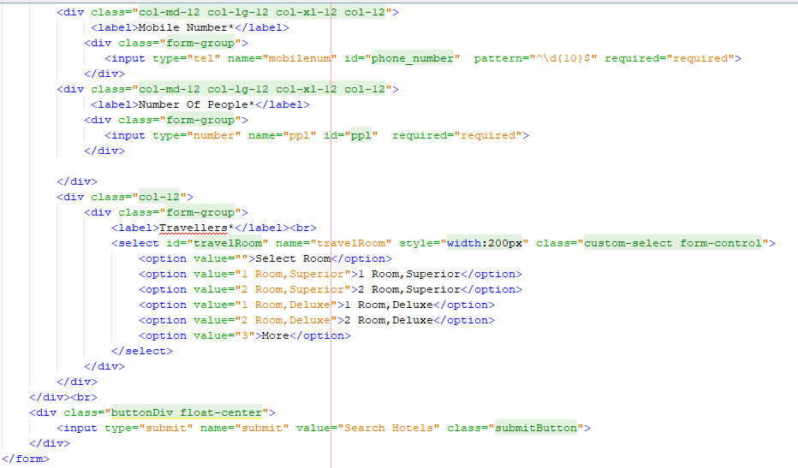
Front-End Code

Slide 34
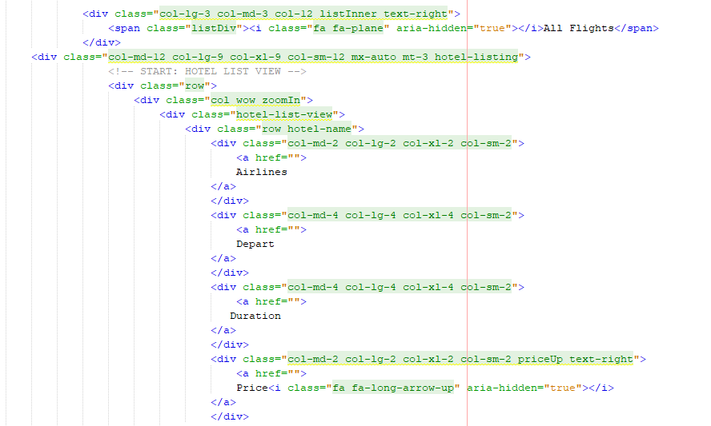
Front-End Code

Slide 35
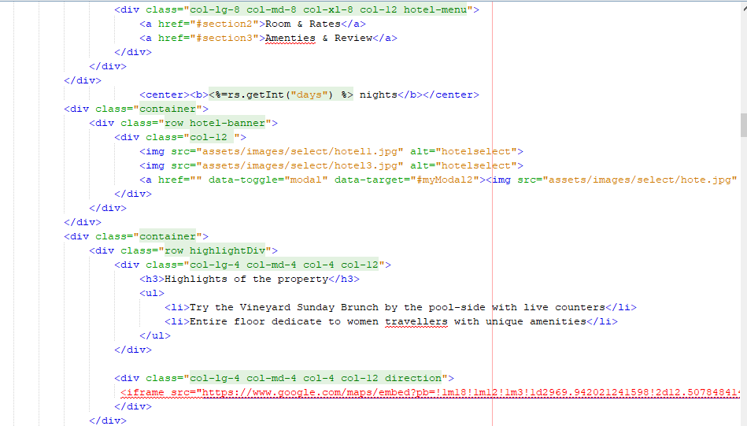
Front-End Code

Slide 36
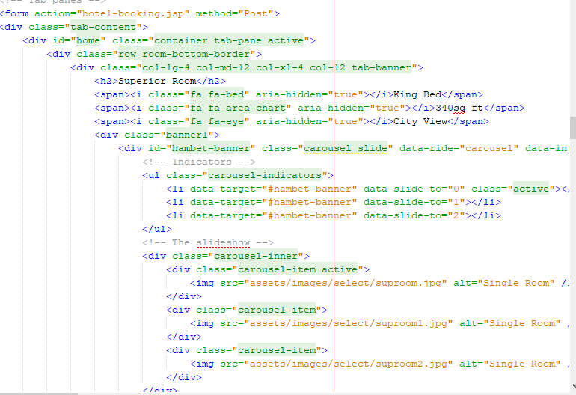
Front-End Code

Slide 37
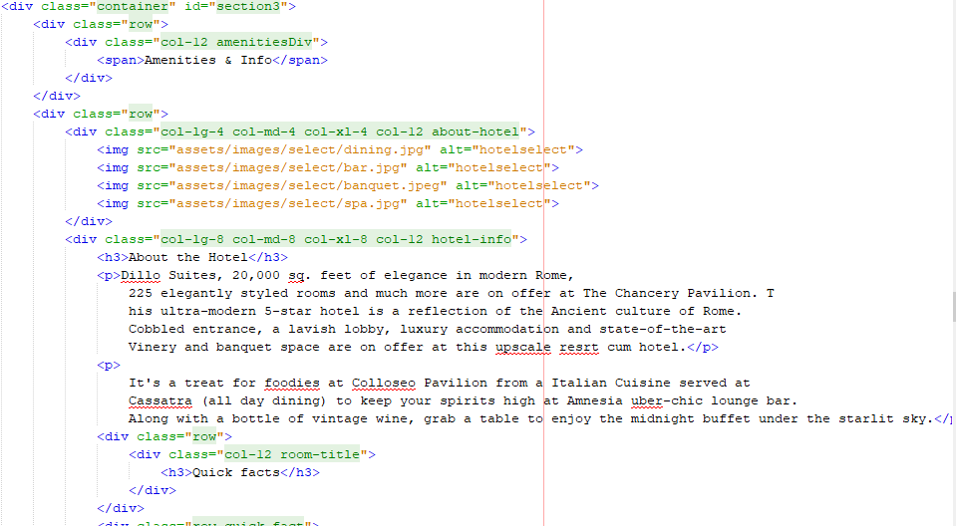
Front-End Code

Slide 38
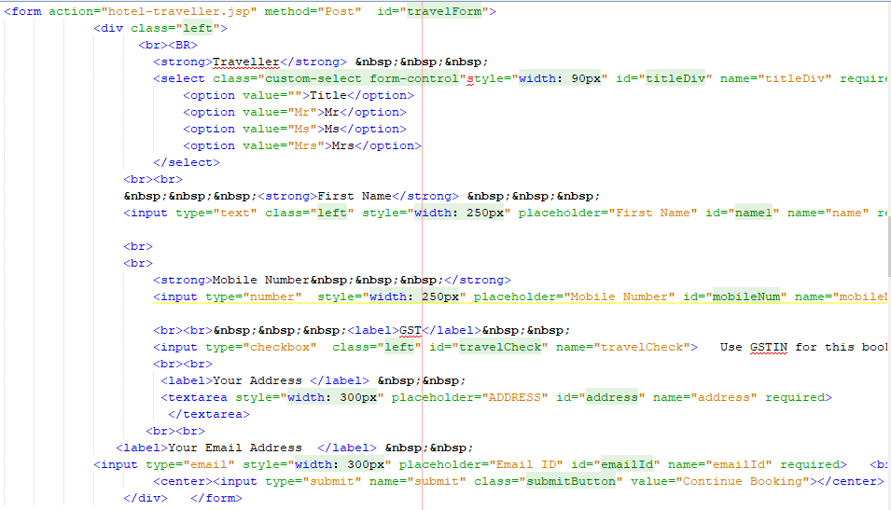
Front-End Code

Slide 39
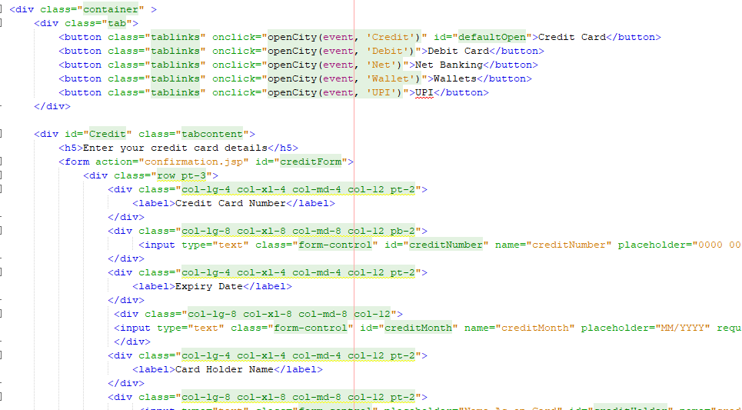
Front-End Code

Slide 40
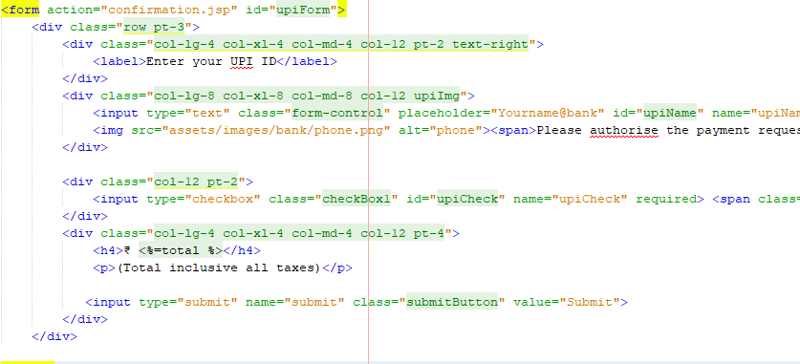
Front-End Code

Slide 41
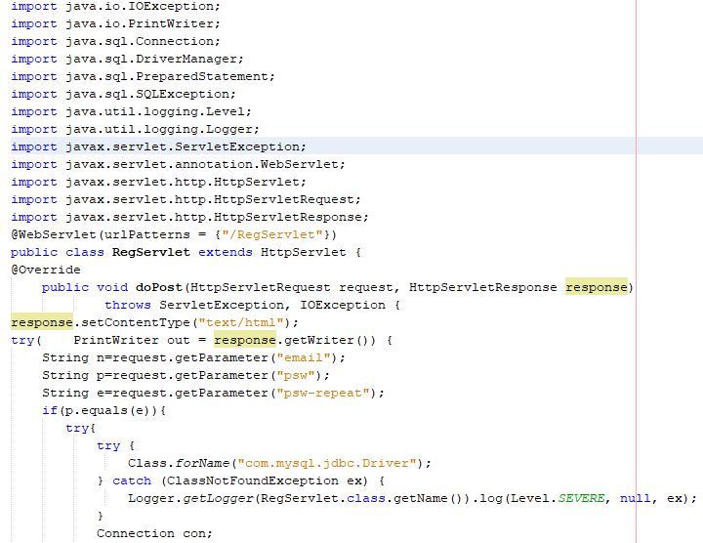
Backend/Database Code
RegServlet.java

Slide 42
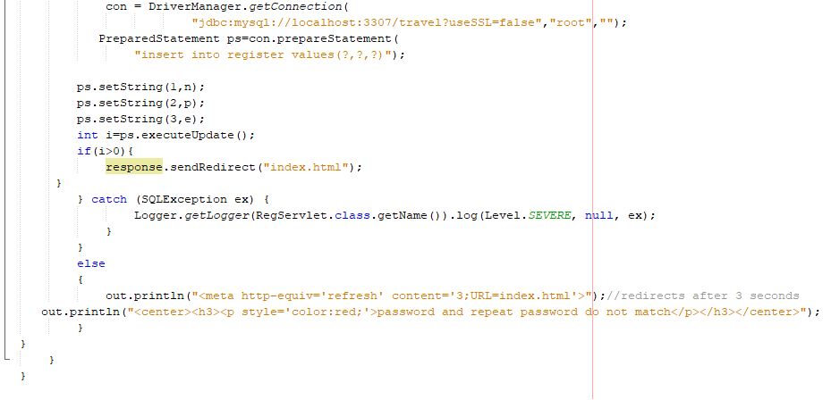
Backend/Database Code

Slide 43
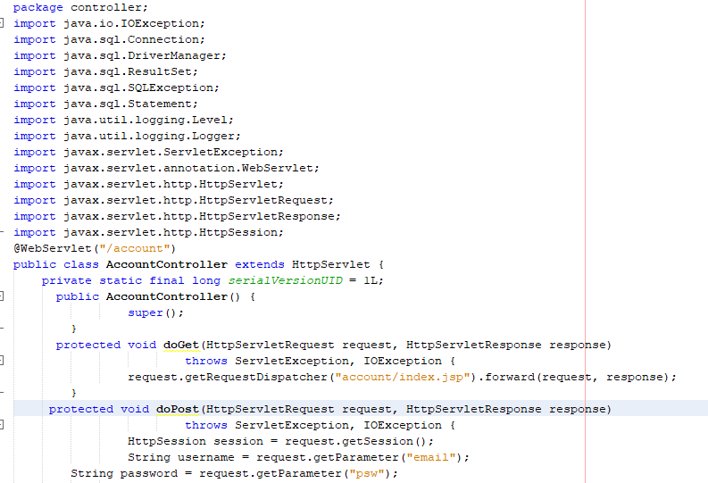
Backend/Database Code
AccountController.java

Slide 44
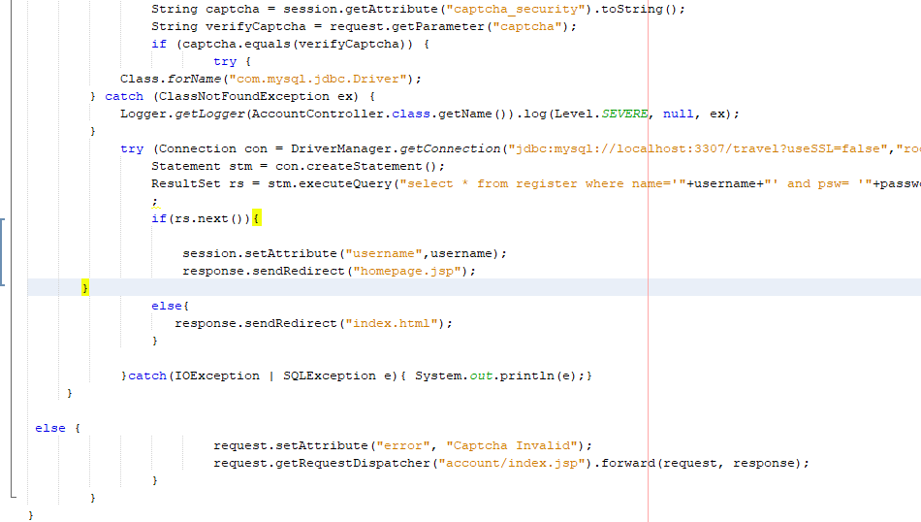
Backend/Database Code

Slide 45
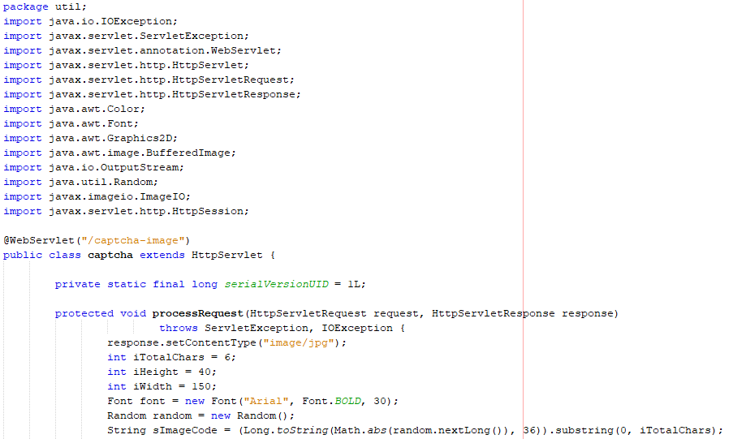
Backend/Database Code
captcha.java

Slide 46
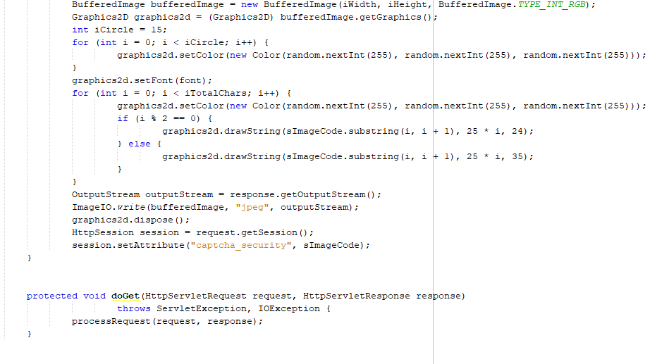
Backend/Database Code

Slide 47
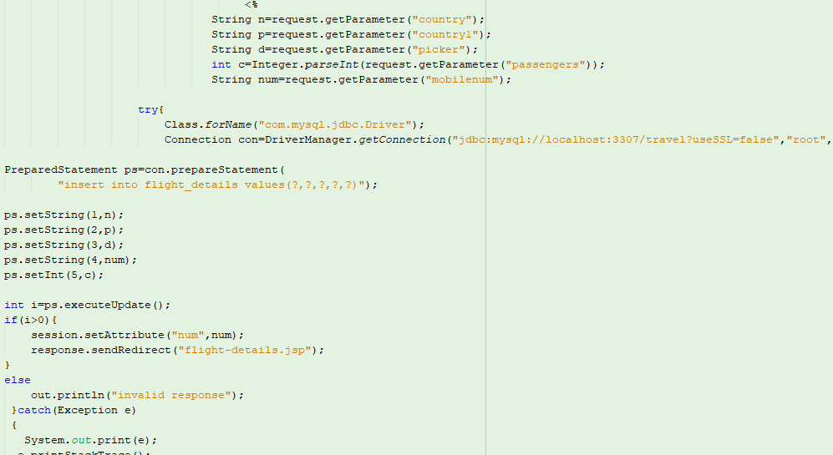
Backend/Database Code

Slide 48
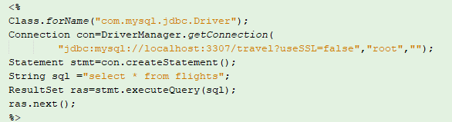
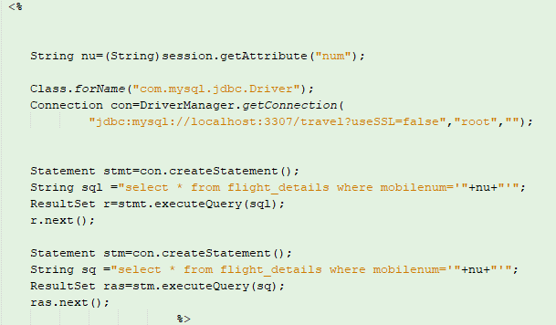
Backend/Database Code

Slide 49
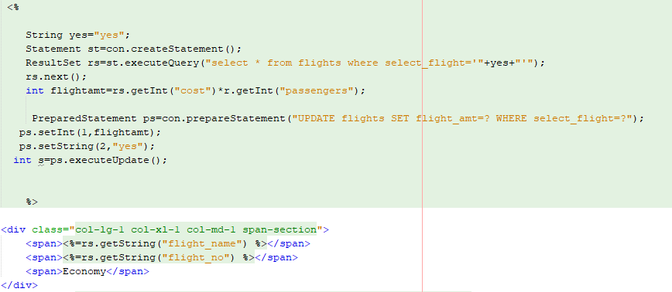
Backend/Database Code

Slide 50
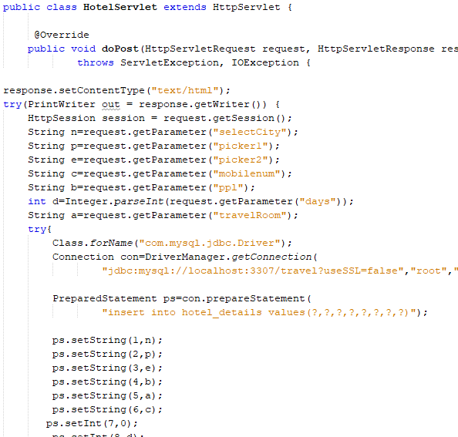
Backend/Database Code

Slide 51
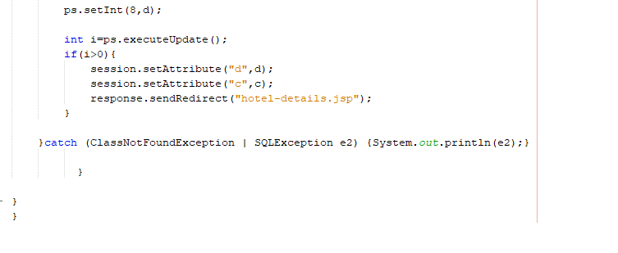
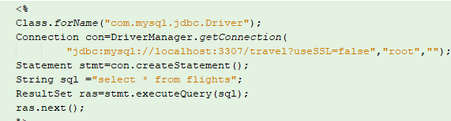
Backend/Database Code

Slide 52
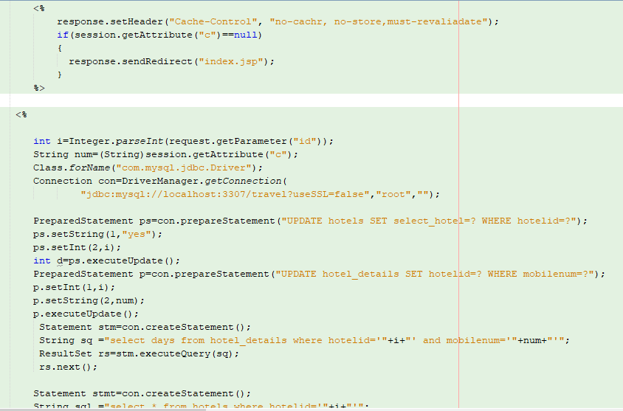
Backend/Database Code

Slide 53
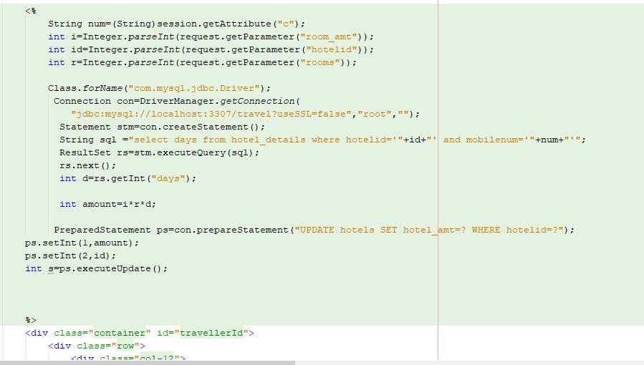
Backend/Database Code

Slide 54
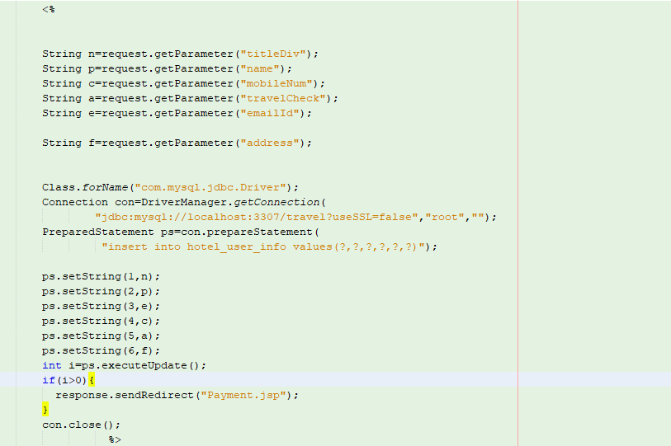
Backend/Database Code

Slide 55
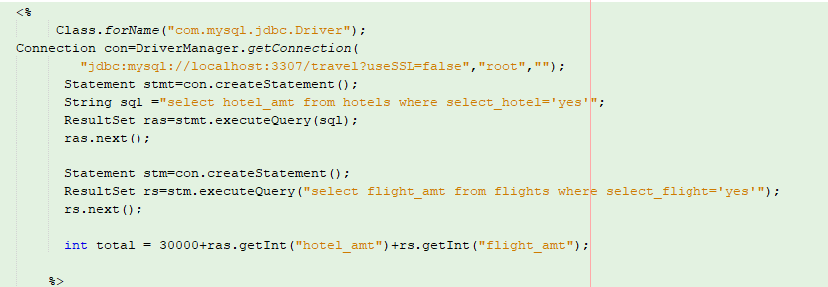
Backend/Database Code

Slide 56
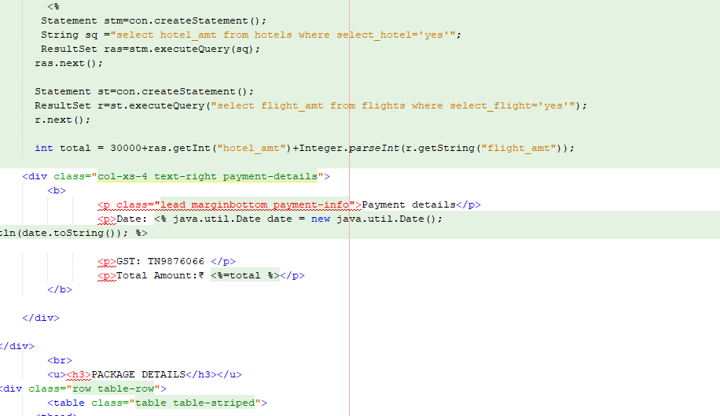
Backend/Database Code

Slide 57
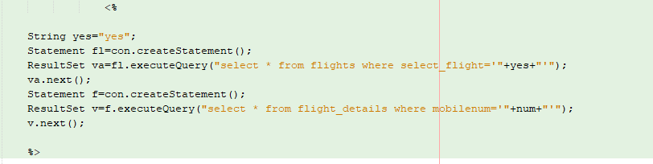
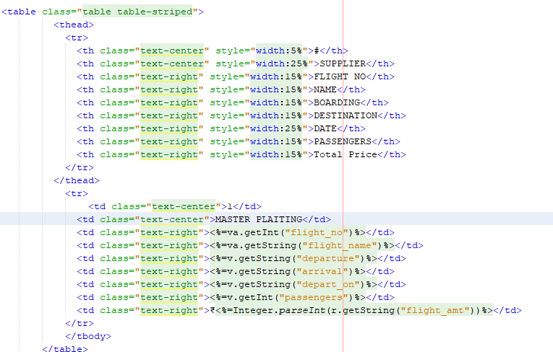
Backend/Database Code

Slide 58
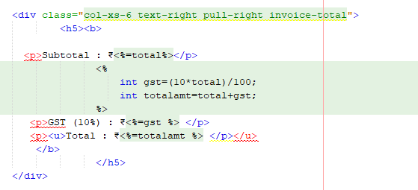
Backend/Database Code

Slide 59
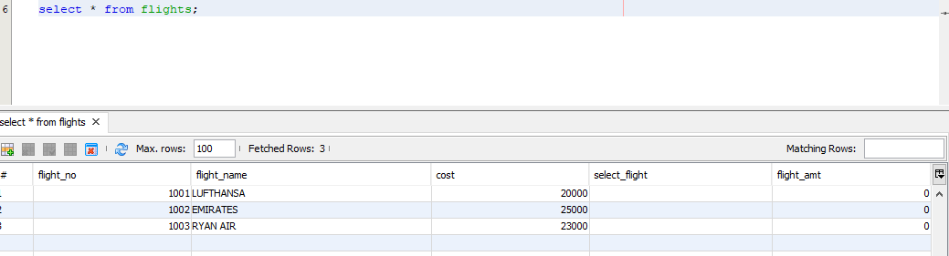

Backend/Database Code

Slide 60


Backend/Database Code

Slide 61

Backend/Database Code

Slide 62

Output/Screen Shots

Slide 63

Output/Screen Shots

Slide 64

Output/Screen Shots

Slide 65

Output/Screen Shots

Slide 66

Output/Screen Shots

Slide 67

Output/Screen Shots

Slide 68

Output/Screen Shots

Slide 69

Output/Screen Shots

Slide 70

Output/Screen Shots

Slide 71

Output/Screen Shots

Slide 72

Output/Screen Shots

Slide 73

Output/Screen Shots

Slide 74

Output/Screen Shots

Slide 75

Output/Screen Shots

Slide 76

Output/Screen Shots

Slide 77

Output/Screen Shots

Slide 78

Output/Screen Shots

Slide 79

Output/Screen Shots

Slide 80

Output/Screen Shots

Slide 81

Output/Screen Shots

Slide 82

Output/Screen Shots

Slide 83

Output/Screen Shots

Slide 84

Output/Screen Shots

Slide 85

Output/Screen Shots

Slide 86

Output/Screen Shots

Slide 87
Conclusion
This is our travel website which provides the entire package details.This web application was successfully created and stored all the travel tourism packages booking, creation managing and tour details into the database using this application. The application was tested very well and the errors were properly debugged. Testing also concluded that the performance of the system is satisfactory. All the necessary output is generated. This system thus provides an easy way to automate all the functionalities of consumption. If this application is implemented in few consumption, it will be helpful. Further enhancements is to be made to the project, so that the website functions in a very attractive and useful manner than the present one. It is concluded that the application works.

Slide 88
Queries?

Slide 89
Thank you

